Slide 1
Homework I: Techniques
Team “SYChienIsGod”: 洪培恒 曾泓諭 柯揚 李啟為

Slide 2
Basics
Language: Python
Framework: Theano
→Both allow for quick prototyping
Network Architecture: Fully connected layers and multiple frames as input

Slide 3
Techniques Employed
Preprocessing: Data standardisation/normalisation
Gradient descent: momentum + learning rate decay
Nonlinearities: ReLU + PReLU
Regularisation: DropOut/DropConnect
Ensemble: Bagging + Blending

Slide 4
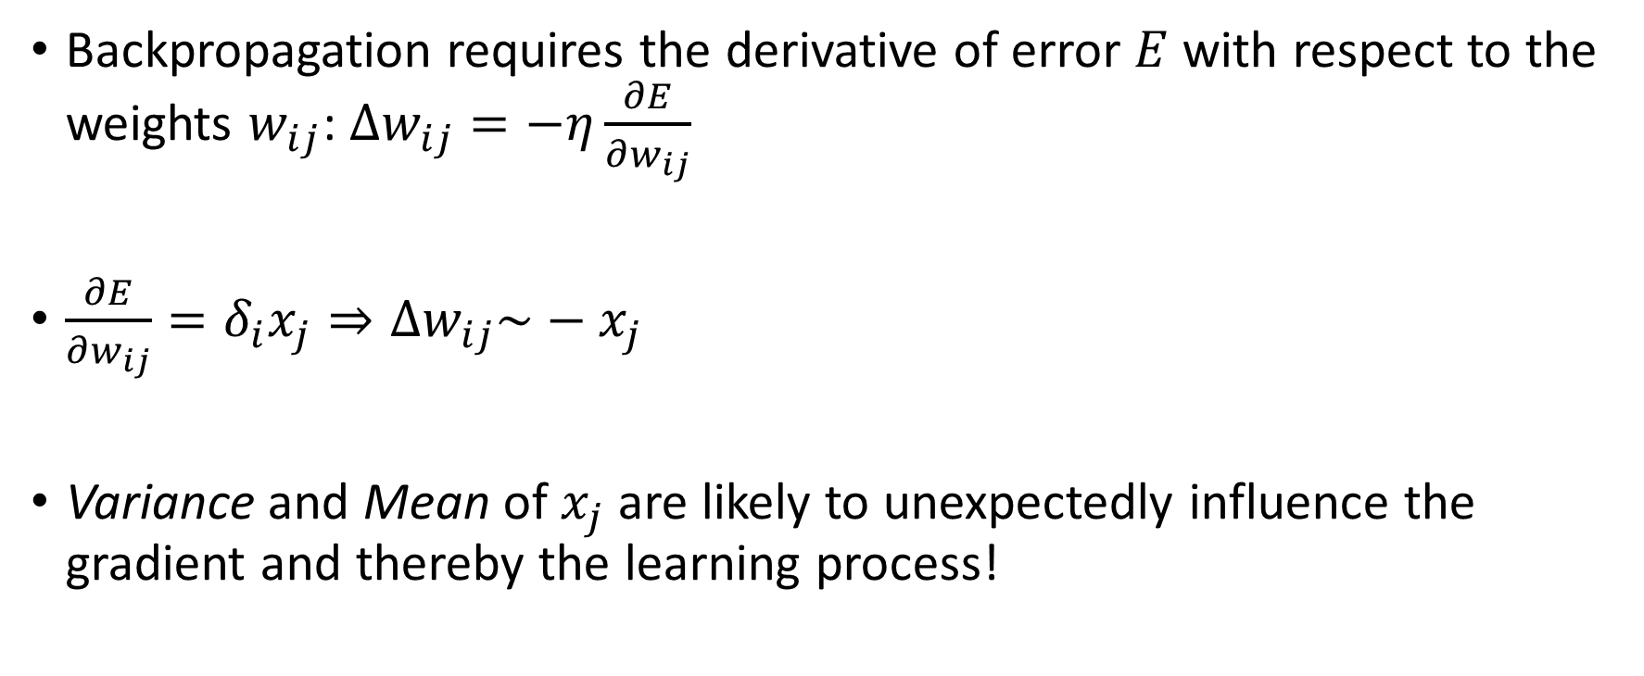
Data Preprocessing
Backpropagation requires the derivative of error $E$ with respect to the weights $w_{ij}$: $Δw_{ij}=−η\frac{∂E}{∂w_{ij}}$
$\frac{∂E}{∂w_{ij}}=δ_{i}x_{j}⇒Δw_{ij}\sim −x_{j}$
Variance and Mean of $x_{j}$ are likely to unexpectedly influence the gradient and thereby the learning process!

Slide 5
Gradient descent
Learning rate decay lets you walk deep into the optimum
Momentum keeps you going on at early local optima

Slide 6

Nonlinearities: hyperbolic tangent
$\frac{d}{dx}\tanh\left(x\right)=1−\tanh{{\left(x\right)}^{2}}$
No gradient → No learning!

Slide 7

Nonlinearities: Rectified Linear Unit
$ReLU\left(x\right)=\left\{\begin{matrix}x, x>0 \\ 0, else\end{matrix}\right\}$
$\frac{d}{dx}ReLU\left(x\right)=\left\{\begin{matrix}1,x>0 \\ 0,else\end{matrix}\right\}$
$PReLU\left(x;α\right)=\left\{\begin{matrix}x, x>0 \\ αx, else\end{matrix}\right\}$
$\frac{d}{dx}ReLU\left(x;α\right)=\left\{\begin{matrix}1,x>0 \\ α,else\end{matrix}\right\}$

Slide 8
Regularisation: DropOut/DropConnect
Prevent co-evolution of nodes
If a node (nearly) behaves like another node, it hasn’t learned anything!
DropOut: Deactivate random nodes at training time
DropConnect: Deactivate random connections at training time
我很懶，我就做跟A2一樣！
A1
B1
A2
B2
A3
B3

Slide 9
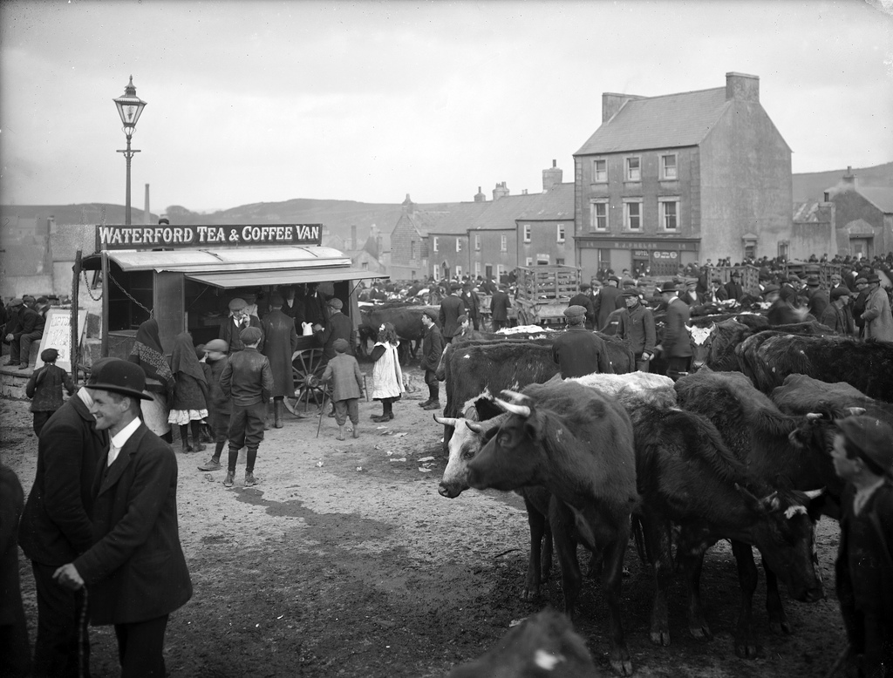
Ensemble: Bagging & Blending
London, England in 1907: People were bored…
→Game at markets: guess the weight of a cow!

Slide 10
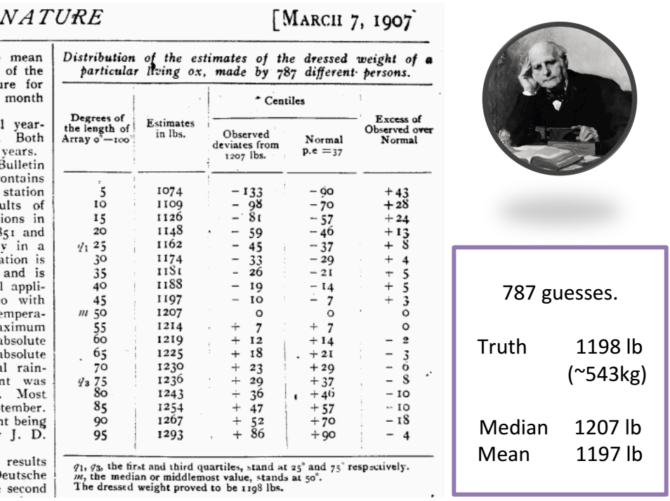
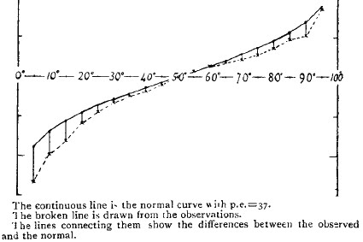
Ensemble: Bagging & Blending
Sir Francis Galton took a closer look at the statistics: the individual error is large but the mean…

Slide 11
Ensemble: Bagging & Blending
Idea: a lot of simple classifiers can be very strong if they are combined
Presumption: their errors are not correlated
Prediction Accuracy | A | B | C | D | E
aa | 0.8 | 0.7 | 0.6 | 0.3 | 0.7
ae | 0.6 | 0.7 | 0.7 | 0.8 | 0.4
ah | 0.7 | 0.4 | 0.8 | 0.7 | 0.7
ao | 0.4 | 0.6 | 0.7 | 0.7 | 0.6
aw | 0.7 | 0.8 | 0.4 | 0.8 | 0.7
A
B
C
D
E

Slide 12
Ensemble: Bagging & Blending
Bagging: Make every classifier a little different by letting him look at different data
→ Randomly select XX% of the data as training data for the classifier

Slide 13
After all…
1% inspiration (灵感)
99% perspiration (流汗)

